Slide 1

ACHARYA INSTITUTE OF TECHNOLOGY Department of Aeronautical Engineering
Technical seminar on:
QUASI TURBINE ENGINE
Presented By:
ANOOP MS - 1AY19AE006
Under the Guidance of
Dr. SWETHA S
Assistant Professor
Dept. of Aeronautical Engineering
Acharya Institute of Technology, Bengaluru.

Slide 2
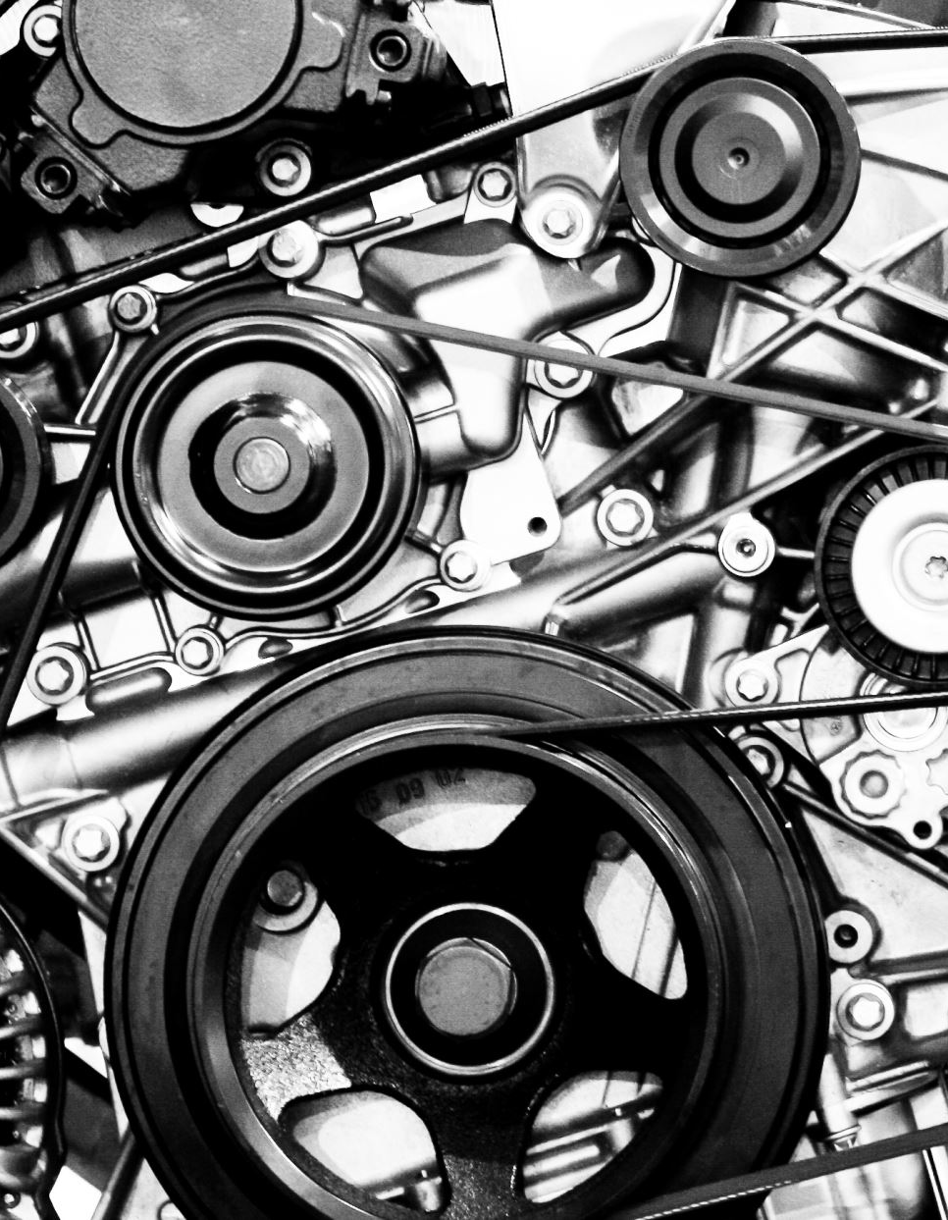
Table of contents
Motivation
Introduction
Types of Internal combustion engine
History review
Working of Quasi turbine
Types of Quasi turbine engine
Advantages and Dis-advantages
Conclusion
Reference

Slide 3
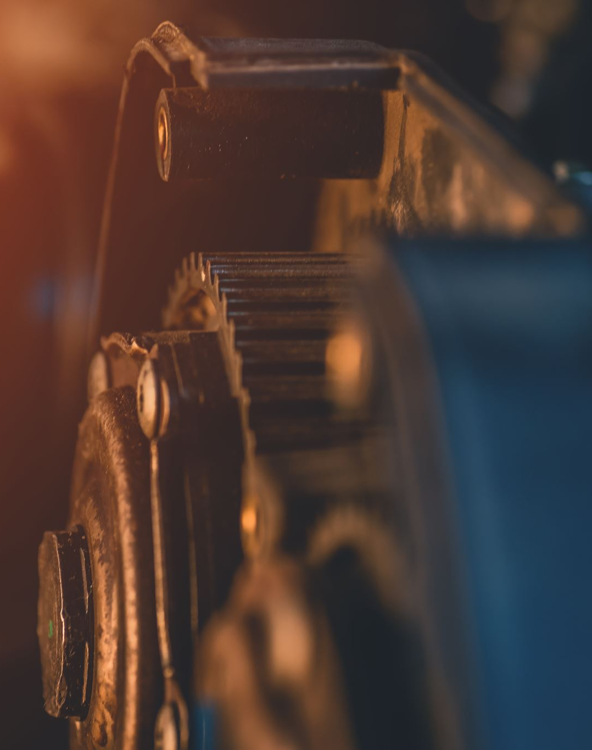
Motivation
The need of a new technology that has the potential to reduce carbon emissions and improve the efficiency of various industries.
Advancements in engineering and technology can lead to more sustainable and efficient solutions for our energy needs.
Engine has no reciprocating parts, making it smoother, more efficient, and more reliable.

Slide 4
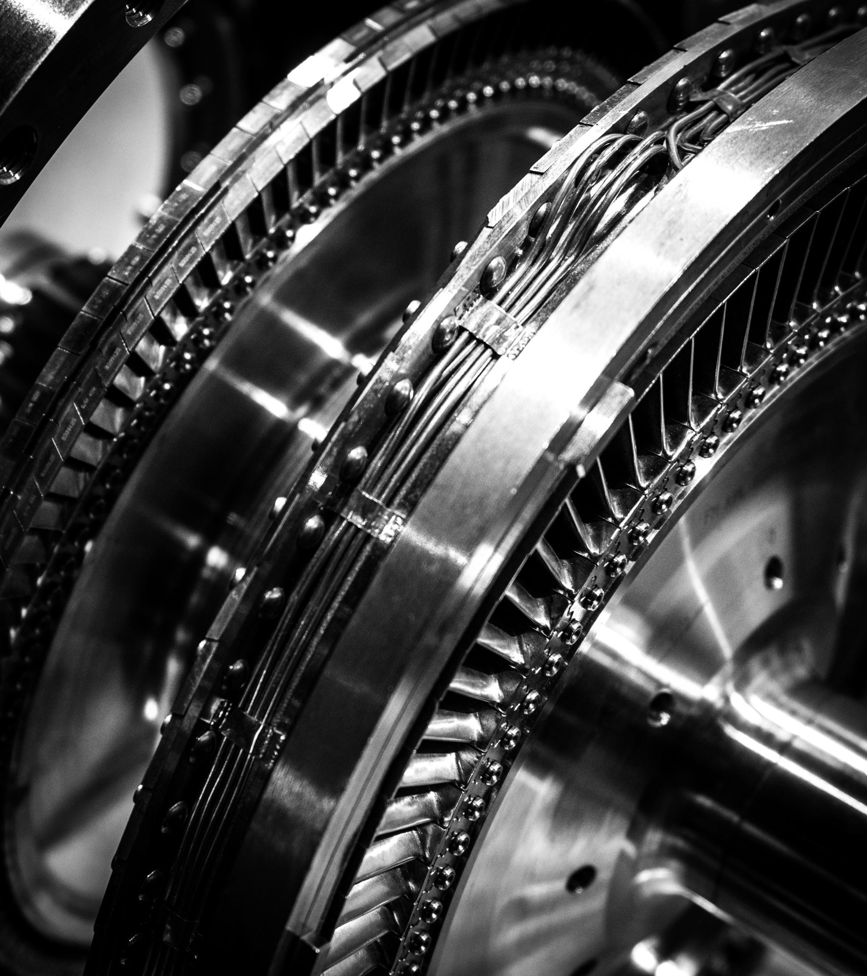
Introduction
Quasi turbine or Quarbine engine - piston less - rotary -engine.
The Quasi turbine or Qurbine engine is a proposed piston less rotary engine using a rhomboidal rotor whose sides are hinged at the vertices.
It is a compact, low weight, high torque machine - with top efficiency.
It is a no crankshaft rotary engine - having 4 faces rotor with a free and accessible center - without vibration - not dead time.
The deformable rotor - blades are hinged at the vertices.
The volume enclosed between the sides of the rotor and the rotor casing provide compression and expansion in a fashion similar to the more familiar Wankel engine, but the hinging at the edges allows the volume ratio to increase.

Slide 5
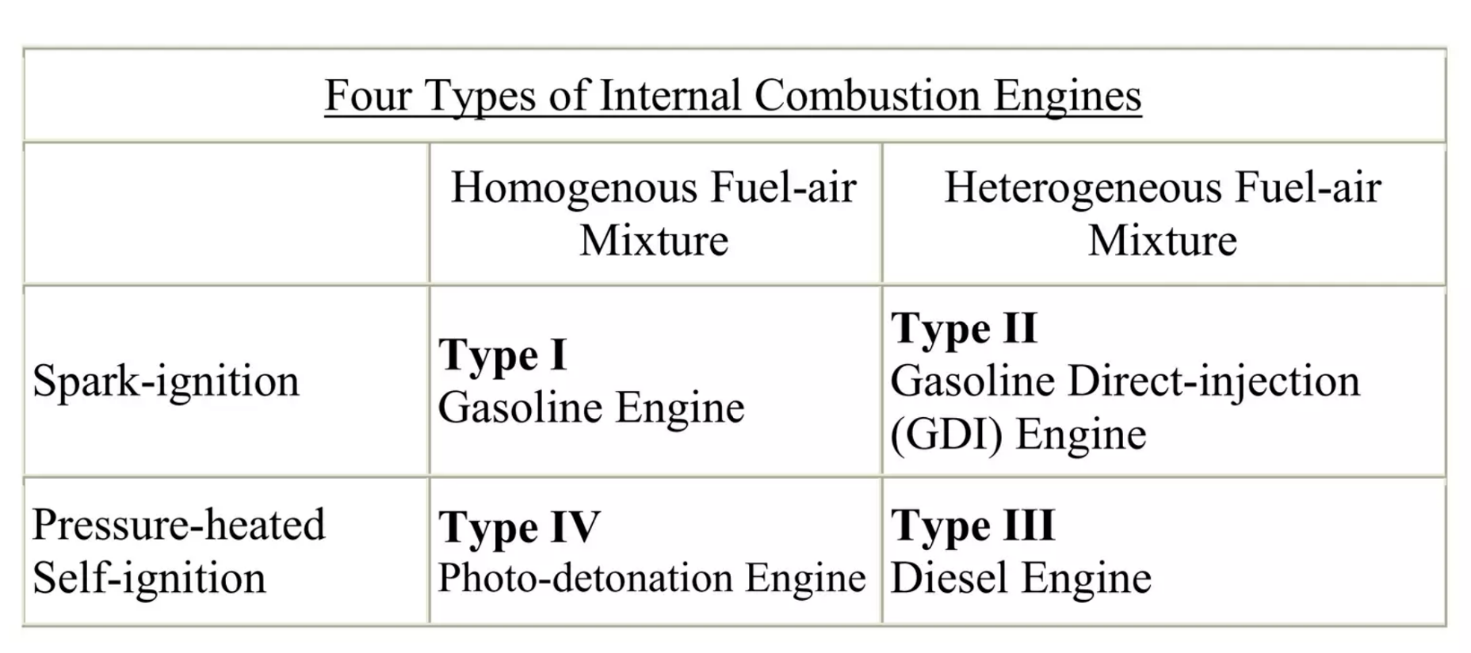
Types of Internal combustion engine
Internal combustion engines fall into four categories based on how well air and fuel are mixed in the combustion chamber and how the fuel is ignited.

Slide 6
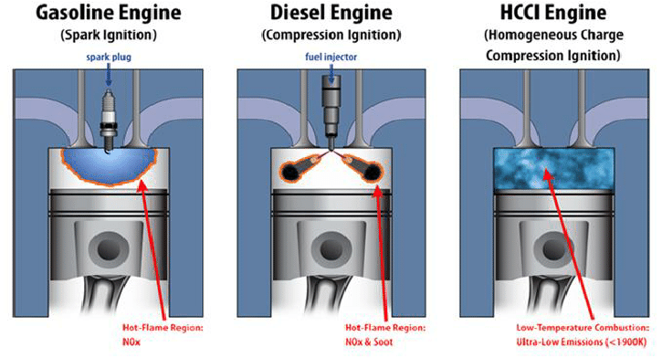
Type I: Includes engines in which the air and fuel mix thoroughly to form what is called a homogenous mixture. When a spark ignites the fuel, a hot flame sweeps through the mixture, burning the fuel as it goes. This, of course, is the gasoline engine.
Type II: A gasoline-direct injection engine uses partially mixed fuel and air i.e., a heterogeneous mixture that is injected directly into the cylinder rather than into an intake port. A spark plug then ignites the mixture, burning more of the fuel and creating less waste.

Slide 7
Type III: Air and fuel are only partially mixed in the combustion chamber. This heterogeneous mixture is then compressed, which causes the temperature to rise until self-ignition takes place.
Type IV: The best attributes of gasoline and diesel engines are combined. premixed fuel-air charge undergoes tremendous compression until the fuel self-ignites. This is what happens in a photo-detonation engine, and because it employs a homogenous charge and compression ignition, it is often described as an HCCI engine. HCCI(Homogeneous Charge Compression Ignition) combustion results in virtually no emissions and superior fuel efficiency. This is because photo-detonation engines completely combust the fuel, leaving behind no hydrocarbons to be treated by a catalytic converter or simply expelled into the air.

Slide 8
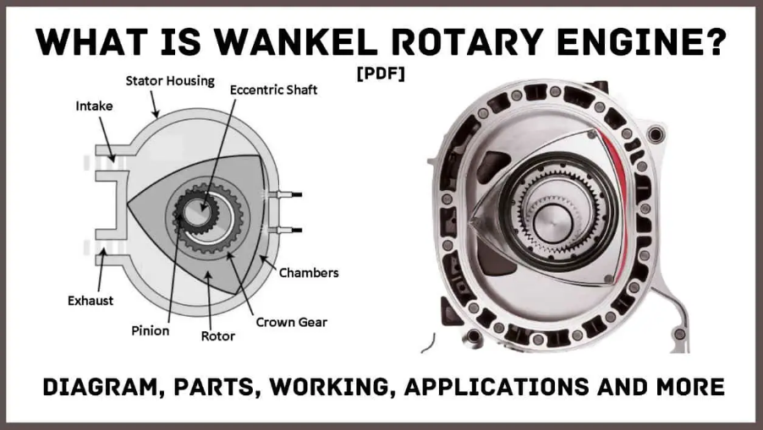
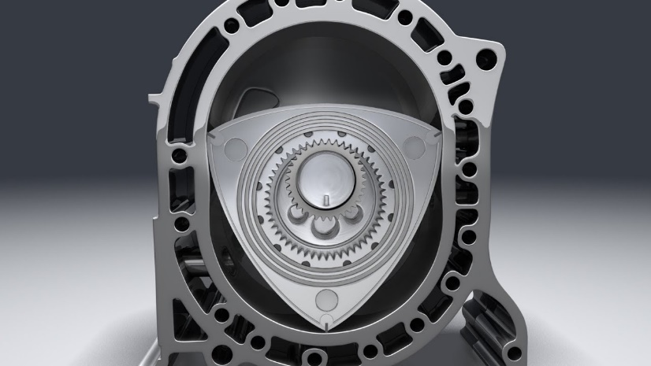
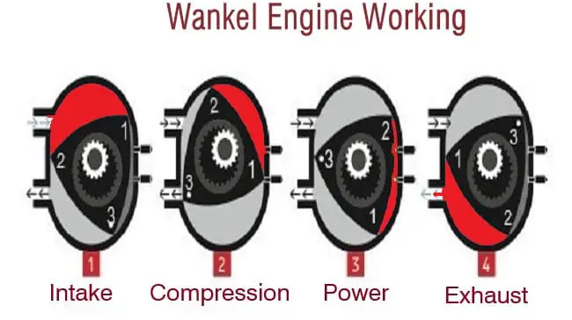
ROTARY ENGINE
As the spark plug ignites the air/fuel blend, the building pressure pushes the rotor to move further.
As the rotor marches on, the volume of the chamber grows.
The combustion gasses keep expanding, pushing the rotor, initiating power until the rotor comes across the exhaust port.

Slide 9
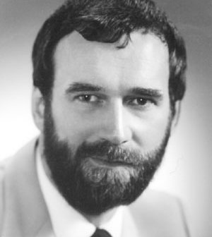
History review
Invented by group of four researchers lead by Dr. Gilles Saint Hillarie
The Saint - Hilaire family first patented the Quasi turbine combustion engine in 1996.

Slide 10
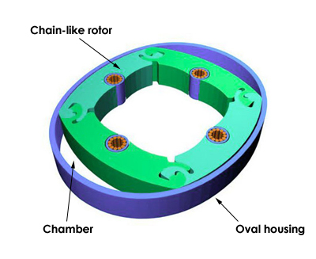
The Quasi turbine concept resulted from research that began with an intense evaluation of all engine concepts to note advantageous, disadvantageous and opportunities for improvement.
During this exploratory process, the Saint - Hilaire team came to realize that a unique engine solution would be one that made improvements to the standard Wankel or rotary engine.
Like rotary engines, the Quasi turbine engine is based on a rotor-and-housing design.
But instead of three blades, the Quasi turbine rotor has four elements chained together, with combustion chamber located between each element and the walls of the housing

Slide 11
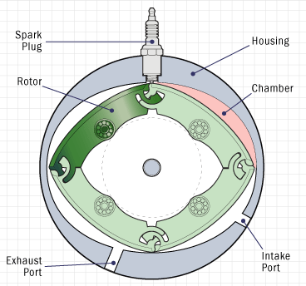
Working of Quasi turbine
The basic working principle of Quasi turbine is same as internal combustion engine.
In a piston engine, one complete four-stroke cycle produces two complete revolutions of the crankshaft that means the power output of a piston engine is half a power stroke per one piston revolution.
A Quasi turbine engine, on the other hand, doesn't need pistons.
Instead, the four strokes of a typical piston engine are arranged sequentially around the oval housing.
There's no need for the crankshaft to perform the rotary conversion.

Slide 12
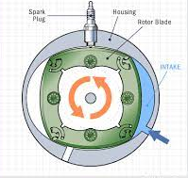
The principle of any IC Engine involves:
INTAKE
which draws in a mixture of fuel and air.

Slide 13
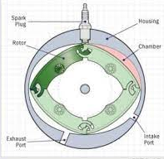
COMPRESSION
which squeezes the fuel - air mixture into a smaller volume.

Slide 14
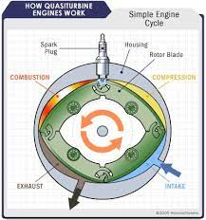
COMBUSTION
which uses a spark from a spark plug to ignite the fuel.
EXHAUST
which expels waste gases (by-products) from the engine.

Slide 16
Types of Quasi turbine engine
Quasi turbine with-out Carriages
The rotor turns inside a nearly oval shaped housing ,Sides of a rotor seal against the sides of housing, Corners of the rotor seal against inner periphery dived into four chambers.

Slide 17
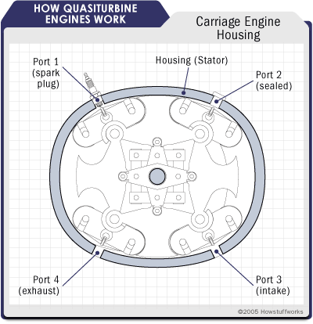
2. Quasi turbine with Carriages
The housing which is a near oval known as the "Saint-Hilaire skating rink," forms the cavity in which the rotor rotates. The housing contains four ports:
A port where the spark plug normally sits
A port that is closed with a removable plug.
A port for the intake of air.
An exhaust port used to release the waste gases of combustion.
The housing is enclosed on each side by two covers. The covers have three ports of their own, allowing for maximum flexibility in how the engine is configured. For example, one port can serve as an intake from a conventional carburetor or be fitted with a gas or diesel injector, while another can serve as an alternate location for a spark plug. One of the three ports is a large outlet for exhaust gasses.

Slide 18
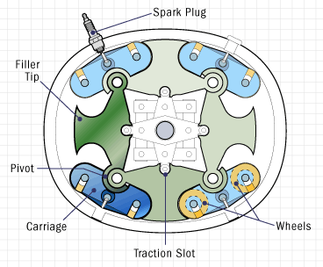
How the various ports are used depends on whether the automotive engineer wants a traditional internal combustion engine or one that delivers the super-high compression required of photo-detonation.
The rotor, made of four blades, replaces the pistons of a typical internal combustion engine.
Each blade has a filler tip and traction slots to receive the coupling arms. A pivot forms the end of each blade.
The job of the pivot is to join one blade to the next and to form a connection between the blade and the rocking carriages. There are four rocking carriages total, one for each blade. Each carriage is free to rotate around the same pivot so that it remains in contact with the inner wall of the housing at all times.
Each carriage works closely with two wheels, which means there are eight wheels altogether. The wheels enable the rotor to roll smoothly on the contoured surface of the housing wall and are made wide to reduce pressure at the point of contact.

Slide 19
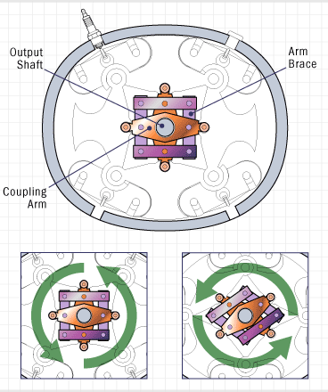
The Quasi turbine engine doesn't need a central shaft to operate; but of course, a car requires an output shaft to transfer power from the engine to the wheels.
The output shaft is connected to the rotor by two coupling arms, which fit into traction slots, and four arm braces.

Slide 20
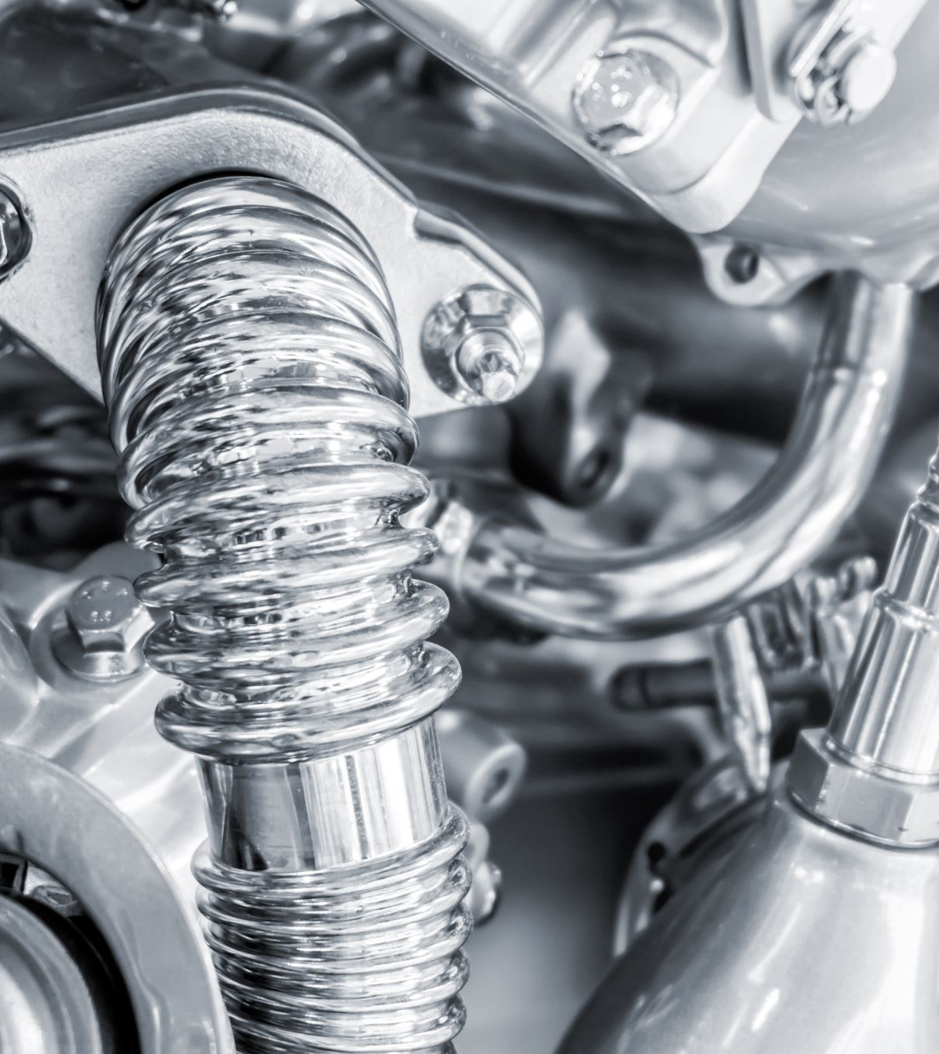
Advantages and Dis-advantages
Advantages
Simple design and small size
Less noisy
Less vibrations are produced because the engine is perfectly balanced
High thermal efficiency
Better conversion and transmission of mechanical energy
Better torque continuity
Faster acceleration
Higher torque at lower RPM
Nearly oil free operation
Fewer moving parts so less wear and tear
Compatible with photo detonation
Multi fuel ability

Slide 21
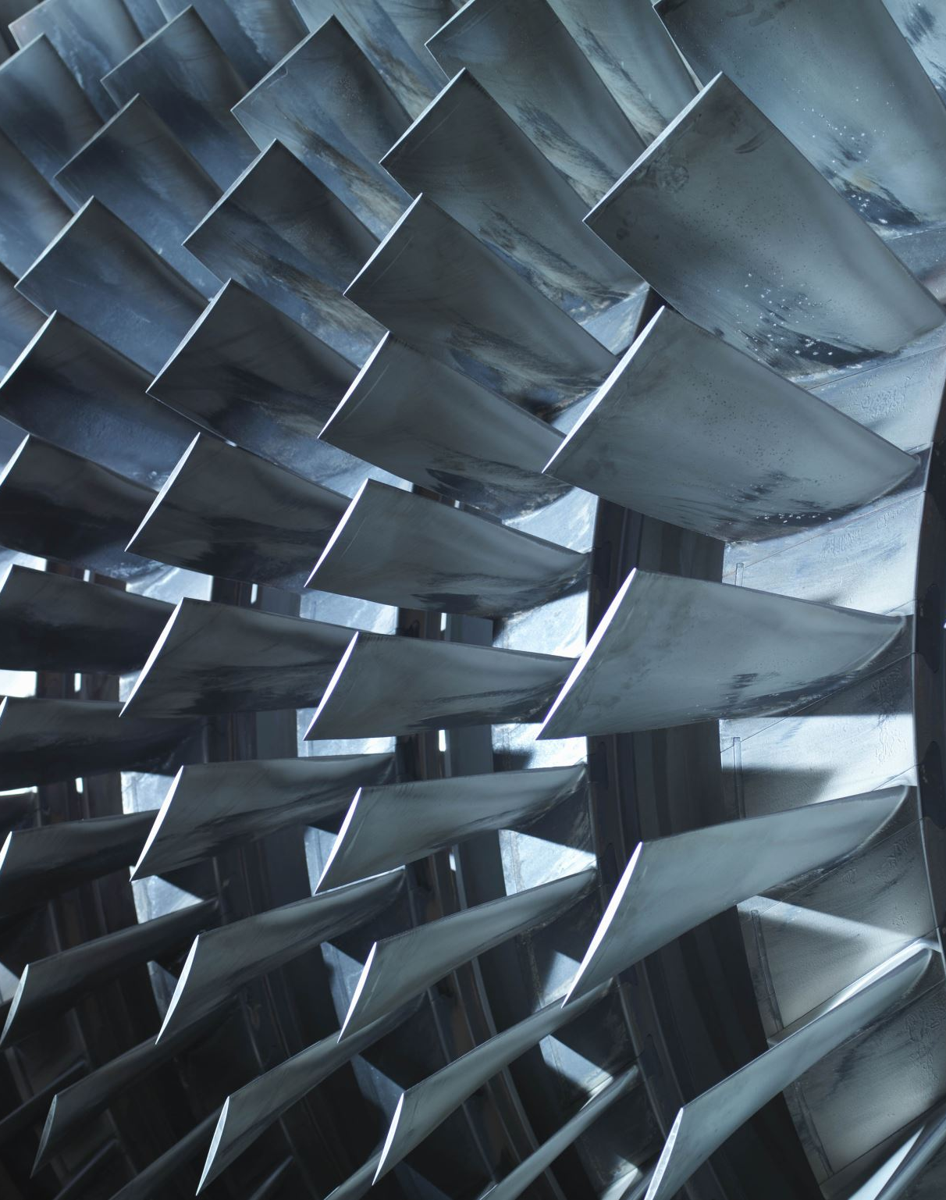
Dis-advantages
The quasi turbine is built with aluminum and cast iron , Differential thermal expansion or contraction in material lead to some incidences of leakage
Construction of rotor is bit difficult.
The quasi turbine is still in infancy. It is not used in real world applications.

Slide 22
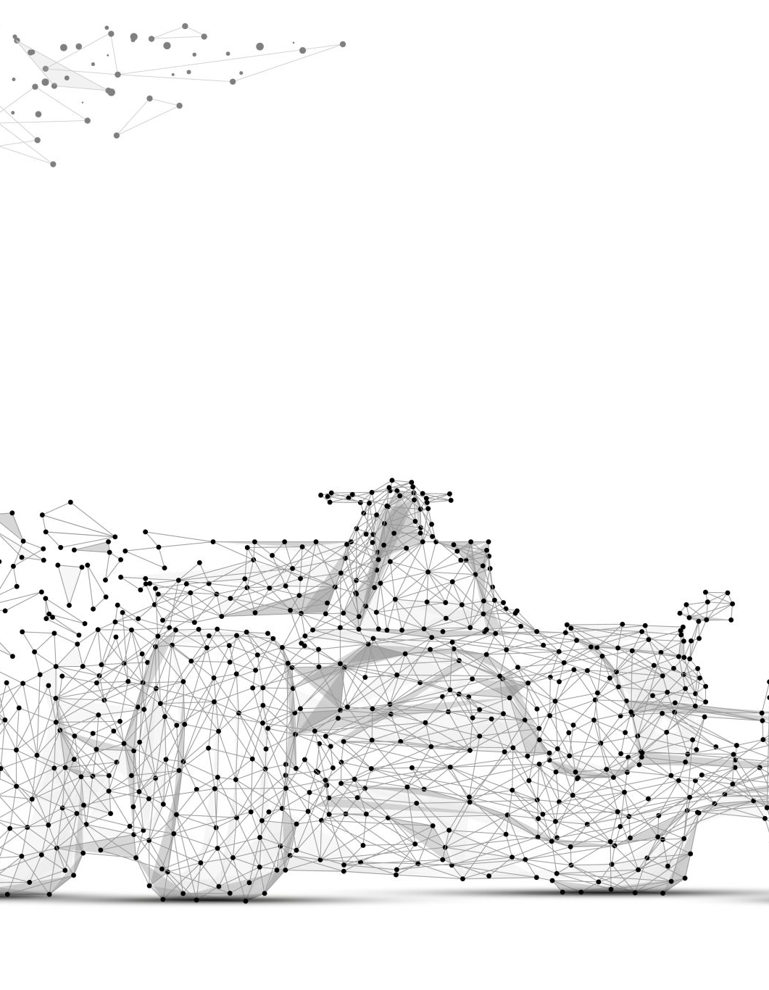
There are at least four proposed designs:
Two-port with carriages, suitable for use as an internal combustion engine.
Four-port without carriages, suitable for use as a pneumatic engine or hydraulic engine, steam engine or pump.
Two-port without carriages, a conceptual design which is hoped to combine some of the advantages of the existing two- and four-port prototypes.
Another conceptual design using a fixed charge of gas, with no ports and without carriages, as a Stirling engine.

Slide 23
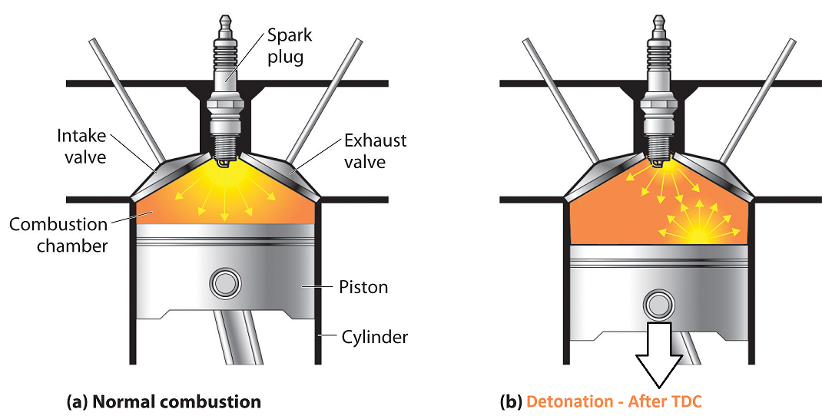
Photo-detonation
The two-port design with carriages was proposed to make possible a new and superior mode of combustion, termed photo-detonation by the Quasi turbine inventors. This resembles detonation, as used in the Bourke engine, akin to knocking and pinging undesirable in common internal combustion engines. As of 2005, no research has been published supporting this claim. A related idea that flame transfer would be possible through special ports is similarly unsupported.

Slide 24
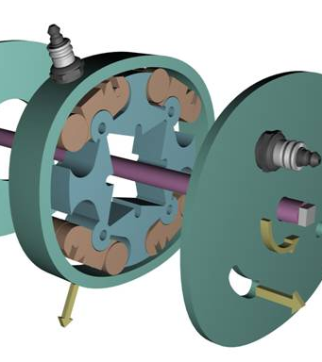
Conclusion
The Quasi turbine is thus a pressure driven engine producing continuous torque with a symmetrically deformable spinning wheel.
The basic limitation of the Quasi turbine engine at a present stage is that it is in its infancy stage.
In the future, however, you will likely see the Quasi turbine used in more than just your car. Because the central engine area is voluminous and requires no central shaft, it can accommodate generators, propellers and other output devices, making it an ideal engine to power chain saws, powered parachutes, snowmobiles, air compressors, ship propulsion systems and electric power plants.

Slide 25
Reference
[1]Pranjal Yadav, Amit Tiwari, Anuj Gupta, Sushant Verma, Sandeep Kumar Singh “Scope of Quasi Turbine: A Review
Analysis” volume no 06 special issue no 02December 2017
[2] MOHAMMED AKRAM MOHAMMED , “Quasi turbine Rotor Development Optimization” , June 2014
[3] Gilles Saint-Hilaire Ph.D.1 , Roxan Saint-Hilaire MBA2 , Ylian Saint-Hilaire M. Sc.3 , Françoise Saint-Hilaire M. Let.4 , “Quasi turbine High Power Density Pump-Expander Engine with Displacement Exceeding External Device Volume for Light and Compact High Torque Applications “
www.quasiturbine.com
www.howstuffworks.com
www.answers.com

Slide 26
THANK YOU

